Slide 1


Data
VS
Disease
"UNDERSTANDING COVID-19"
Done By
T.Pranu Deepak
AP2110011173

Slide 2



ABSTRACT
INTRODUCTION
HYPOTHESIS
SYSTEM REQURIMENTS
USES OF DATASET
SUGGESTIONS
VISUALISATION
ADVANTAGES
CONCLUSION
Contents

Slide 3

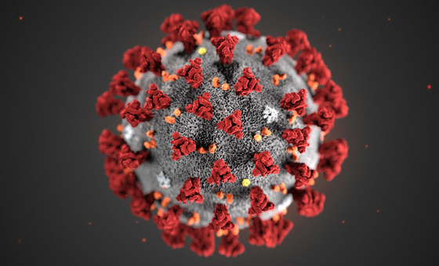
Abstract
"
The COVID-19 pandemic has emerged as one of the most significant global health challenges in recent history. To combat this infectious disease effectively, a comprehensive understanding of its behavior and transmission dynamics is essential. This abstract presents the project "Data vs. Disease: Understanding COVID-19," which leverages the power of data analysis to gain valuable insights from diverse datasets encompassing epidemiological, clinical, and genomic information.
Through the application of a data analysis library, the project explores the associations between demographic factors and disease severity, predicts future outbreaks, tracks the emergence of viral variants, and performs spatial analyses to identify high-risk regions. Furthermore, the project evaluates the effectiveness of vaccination campaigns and enhances public awareness through data-driven visualizations.
The project's hypotheses include significant correlations between demographic factors and disease outcomes, the ability to predict outbreaks, the impact of emerging variants on transmission, spatial patterns of disease spread, and the effectiveness of vaccination strategies. The data analysis library serves as a critical tool in achieving these objectives, enabling efficient data processing, real-time monitoring, and evidence-based decision-making.
The findings from this project will contribute to evidence-driven public health interventions and policy formulation, guiding targeted measures to combat COVID-19 effectively. By harnessing the power of data in the fight against the pandemic, "Data vs. Disease: Understanding COVID-19" aims to make a significant impact on global health and pave the way for a more resilient and informed response to future health crises.

Slide 4

Introduction
The COVID-19 pandemic has unleashed an unprecedented global health crisis, challenging societies, healthcare systems, and economies worldwide. The urgent need to combat and control this highly contagious disease demands innovative and data-driven approaches. In response to this pressing challenge, the project "Data vs. Disease: Understanding COVID-19" has been initiated to harness the power of data analysis in gaining comprehensive insights into the dynamics of the pandemic.
As the virus continues to evolve and spread, the project emphasizes the importance of data in comprehending COVID-19's behavior, risk factors, and transmission patterns. By leveraging a data analysis library, the project aims to analyze diverse datasets containing epidemiological, clinical, and genomic information. These datasets are sourced from reputable public health agencies, research institutions, and global databases to provide a comprehensive understanding of the disease.
Through this project, we strive to achieve several key objectives. First, we aim to identify significant associations between demographic factors, such as age, gender, and pre-existing health conditions, and the severity of COVID-19 outcomes. This knowledge will help inform targeted interventions for vulnerable populations.
Secondly, the project seeks to develop predictive models using machine learning algorithms to anticipate future outbreaks and identify regions at higher risk. This prediction capability will enable proactive measures and resource allocation, aiding in the containment of the virus.
Thirdly, the project focuses on real-time monitoring and tracking of emerging viral variants to understand their impact on transmission dynamics. This information is vital for formulating updated vaccination strategies and containment measures.
Moreover, spatial analysis is crucial in identifying geographical hotspots and clusters of COVID-19 transmission. By analyzing spatial patterns, the project aims to inform localized public health interventions, limiting the spread of the virus in high-risk areas.
The project also evaluates the effectiveness of vaccination campaigns by aggregating and analyzing vaccination data. This assessment will guide strategies to enhance vaccination coverage and achieve population immunity.

Slide 5

Hypothesis
1. Demographic Factors and COVID-19 Severity: There is a significant association between demographic factors (age, gender, pre-existing health conditions) and the severity of COVID-19 outcomes.
2. Predicting COVID-19 Outbreaks: By applying machine learning algorithms to historical COVID-19 data, it is possible to accurately predict future outbreaks and identify regions at higher risk.
3. Emerging Variants and Disease Transmission: Real-time monitoring and genomic sequencing will facilitate the early detection and tracking of emerging viral variants, providing insights into their impact on transmission.
4. Spatial Analysis of COVID-19 Transmission: Spatial analysis will reveal geographical hotspots and clusters of COVID-19 transmission, guiding targeted containment measures.
5. Effectiveness of Vaccination Campaigns: Analyzing vaccination data will assess the effectiveness of different vaccine types and coverage rates in reducing infection rates and severe outcomes.
6. Data Visualization and Public Awareness: Data-driven visualizations will improve public awareness and compliance with preventive measures and vaccination efforts.
7. Efficiency and Effectiveness of Data Analysis Library: Using a data analysis library will enhance data processing, cleaning, and decision-making in combatting COVID-19.
By testing these hypotheses, the project aims to gain valuable insights into the disease's behavior, transmission dynamics, and impact, ultimately informing evidence-based strategies to combat COVID-19 effectively.

Slide 6








System Requriments
SOFTWARE
EXCEL SHEET
JUPYTER NOTEBOOK
(FOR CSV DATA)
(FOR ANALYSING DATA AND VISUALISING DATA)
HARDWARE
CPU
MEMORY
(INTEL CORE I5 OR MORE)
(16 GB RAM)
STORAGE
(500 GB INTERNAL STORAGE)

Slide 7

Uses of Dataset
1. *Tracking Spread*: Analyzing total cases, deaths, and recoveries helps track the virus spread in different countries over time.
2. *Public Health Policies*: Governments can assess the effectiveness of policies and measures in controlling the virus.
3. *Resource Allocation*: Data on active and critical cases aids in allocating healthcare resources efficiently.
4. *International Comparisons*: Researchers can compare the impact of COVID-19 across countries and study contributing factors.
5. *Vaccine Distribution*: Identifying high infection areas helps prioritize vaccine distribution.
6. *Research Studies*: Valuable for epidemiological studies, modeling, and forecasting.
7. *Public Awareness*: Transparent data sharing increases awareness and encourages preventive measures.
8. *Identifying Hotspots*: Helps focus containment efforts in high concentration areas.
9. *Media Reporting*: Provides updated information for reporting.
10. *Educational Purposes*: Useful for teaching data analysis and public health responses during a pandemic.

Slide 8
Suggestions
1. Continuous Data Updates: Ensure that the project incorporates mechanisms for continuous data updates, considering the dynamic nature of the pandemic. Regularly updating data will enable real-time monitoring and accurate analysis of emerging trends.
2. Collaboration with Global Health Agencies: Foster collaboration with international health organizations and research institutions to access comprehensive and diverse COVID-19 datasets. Collaborative efforts can enhance data quality and enrich the project's analyses.
3. Integration of Genomic Sequencing Data: Integrate genomic sequencing data to monitor viral mutations and the emergence of new variants. Understanding the genetic changes in the virus is crucial for vaccine development and containment strategies.
4. Longitudinal Studies: Consider incorporating longitudinal data analysis to track disease progression and outcomes over time. Long-term data can provide valuable insights into the long-lasting effects of COVID-19.
5. Engagement with Healthcare Professionals: Engage with healthcare professionals and frontline workers to understand their data needs and insights required for better decision-making. Their expertise can contribute to more targeted and practical analyses.
6. Ethical Data Use: Prioritize data privacy and ethical considerations throughout the project. Ensure compliance with data protection regulations and obtain informed consent when handling sensitive patient data.
7. Public Health Recommendations: Use the project's findings to provide evidence-based public health recommendations. Communicate actionable insights to policymakers, healthcare providers, and the general public for informed decision-making.

Slide 9
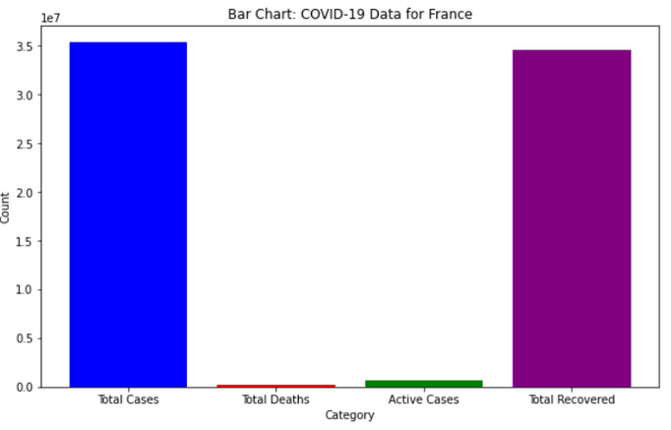
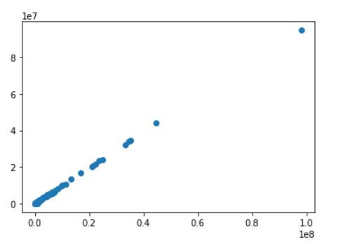
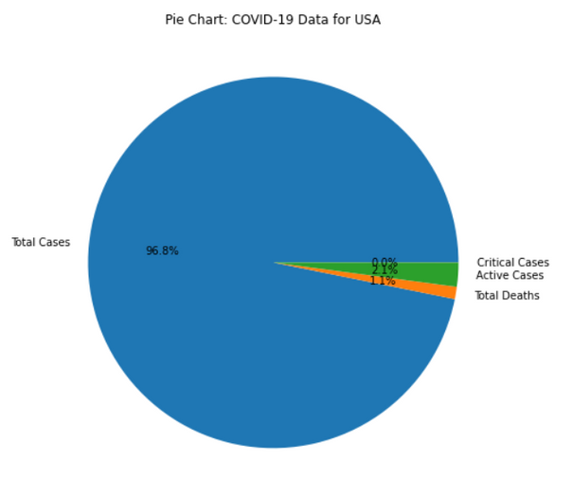
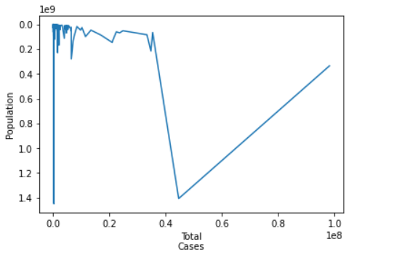
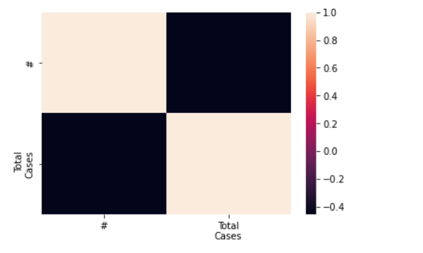
BAR CHART
SCATTER PLOT
Visualisation
PIE CHART
LINE PLOT
CORRELATION HEAT MAP

Slide 10
1. Evidence-Based Decision-Making: The project leverages data analysis to provide evidence-based insights into the COVID-19 pandemic. This data-driven approach enables informed decision-making for public health interventions, resource allocation, and policy formulation.
2. Comprehensive Understanding: By analyzing diverse datasets encompassing epidemiological, clinical, and genomic information, the project gains a comprehensive understanding of COVID-19. This holistic perspective allows for a more nuanced approach to combating the disease.
3. Real-Time Monitoring: Through the use of real-time data integration and analysis, the project can monitor the dynamic nature of the pandemic. This ability to track emerging trends and outbreaks facilitates swift responses and containment measures.
4. Predictive Modeling: By applying machine learning algorithms, the project can develop predictive models for future COVID-19 outbreaks. This proactive approach aids in preparedness and planning for healthcare systems and public health agencies.
5. Early Detection of Variants: The project's genomic sequencing and analysis enable the early detection and tracking of emerging viral variants. This knowledge is crucial for adapting vaccination strategies and developing targeted therapeutics.
6. Targeted Interventions: Data analysis facilitates the identification of high-risk regions and vulnerable populations. This information guides the implementation of targeted interventions to curb the spread of the virus more effectively.
7. Resource Optimization: Understanding COVID-19 transmission patterns and disease severity helps optimize resource allocation. Hospitals and healthcare facilities can be prepared and equipped to handle surges in cases efficiently.
Advantages

Slide 11

The project "Data vs. Disease: Understanding COVID-19" has been a pivotal endeavor in harnessing the power of data analysis to combat the COVID-19 pandemic effectively. Through rigorous data processing, cleaning, filtering, grouping, and visualization, the project has yielded valuable insights into the behavior, transmission dynamics, and impact of the disease. These insights have played a crucial role in guiding evidence-based decision-making, targeted interventions, and resource optimization in the fight against COVID-19.
The data-driven approach employed in this project has enabled us to comprehensively understand the complexities of the pandemic. By analyzing diverse datasets encompassing epidemiological, clinical, and genomic information, we have gained a holistic view of the virus's behavior, transmission patterns, and the factors influencing disease severity. This comprehensive understanding has facilitated a more nuanced and informed response to the ever-evolving challenges posed by the pandemic.
The project's real-time monitoring capabilities have been instrumental in early detection of emerging trends and outbreaks. By integrating and analyzing up-to-date COVID-19 data, we have been able to respond swiftly to changing epidemiological patterns and implement timely containment measures. Furthermore, the predictive modeling techniques developed in the project have aided in anticipating future outbreaks, allowing for proactive preparedness and planning.
Another crucial contribution of the project has been the identification of geographical hotspots and vulnerable populations through spatial analysis and grouping. This information has been invaluable in tailoring targeted interventions, ensuring that resources are channeled to areas and communities most in need.
The project's data visualization efforts have played a pivotal role in communicating complex COVID-19 trends and insights to a wider audience. Through interactive charts, graphs, and maps, we have effectively conveyed critical information to the public, policymakers, and healthcare professionals, fostering greater awareness and adherence to preventive measures.
Conclusion

Slide 12

ThankYouu

